Slide 1
RATING PREDICTION
Submitted By | Ankit Dadarwala | Data Science Intern at Flip Robo Technologies

Slide 2

Introduction
Problem Statement:
We have a client who has a website where people write different reviews for technical products. Now they are adding a new feature to their website i.e. The reviewer will have to add stars(rating) as well with the review. The rating is out 5 stars and it only has 5 options available 1 star, 2 stars, 3 stars, 4 stars, 5 stars. Now they want to predict ratings for the reviews which were written in the past and they don’t have a rating. So, we have to build an application which can predict the rating by seeing the review.

Slide 3
Introduction
Goal and Knowledge of Problem:
Multi-class classification originated from the investigation of text categorisation problem, where each document may belong to several predefined topics simultaneously.
For example, multi-label classification makes the assumption that each sample is assigned to one than more class: a fruit can be either an apple or a pear but not both at the same time. Whereas, an instance of multi-class classification can be that a text might be about any of religion, politics, finance or education at the same time or none of these
Our goal is to build a prototype for rating the of online electronic product based on review comments text given by customers.

Slide 4

Exercise
Build a model which can be used to predict in terms of a probability for each Multi-class prediction.
In this case, target column has binary values so we used Classification based models.

Slide 5
Points to remember
There are 71 null values in Dataset.
The data was collected from different e-commerce websites like amazon, flip kart by scraping using selenium tool of different products like phones, laptops, professional cameras, printers, routers, smart watches, monitors. It is hereby given to us for this exercise. In order to build model for online products review rating classification between 1 to 5 stars.
Size of the dataset is 35541 rows and 3 columns with 1 target column
Data are text-data so we need to use NLP approached for ML

Slide 6
Project Goals
Analytical Problem Framing
Exploratory Data Analysis (EDA)
Visualizations
Data Pre-Processing
Model/s Development and Evaluation
Saving the best model and predicting the target
Conclusion and future work discussion

Slide 7
column Description
review titel --> title of review
review comments --> text of review written by users
rating --> No.of rating given out of 5

Slide 8
Exploratory Data Analysis
Data preprocessing
As a first step I have imported required libraries and I have imported the dataset which was scraped and stored in csv or excel format.
Then I did all the analysis like checking shape, value counts, info, duplicates value null values etc.
I have also dropped “unnamed:0”, column as I found they are useless.
While checking for null values I found 71 null values in the dataset.
I have merge review title and review comment columns.
Transform the target column into int base.
Make columns to check length of strings in particular row index comments.
Convert all text data into lower case.
Remove white space and special characters.
Remove html tags from data
Remove non-ascii words from text
Than make CLAENTEXT function to prepare text data, in that function remove string punctuation, tokenize comment in words, remove stop words like(I,me,u,your,have,had,etc…),than using POS TAG(part of speech) lemmatization the words.
Apply this function to review comments column.
Again, make column to check clean text length.
Using TFIDF Vectorize transform text to vectors and extract features for models
Shape : 35541 rows and 3 columns
71 null values present
No Duplicate record found
Datatypes of objective and int present

Slide 9
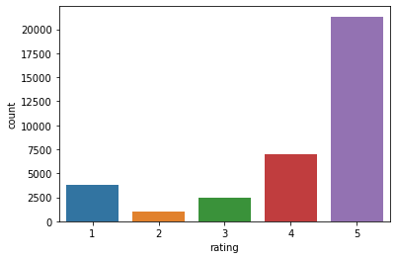
Label Distribution plot
Counts of comment class are shown bar chart in terms of rating b/w 1 to 5
Most of product rated 5 star.

Slide 10
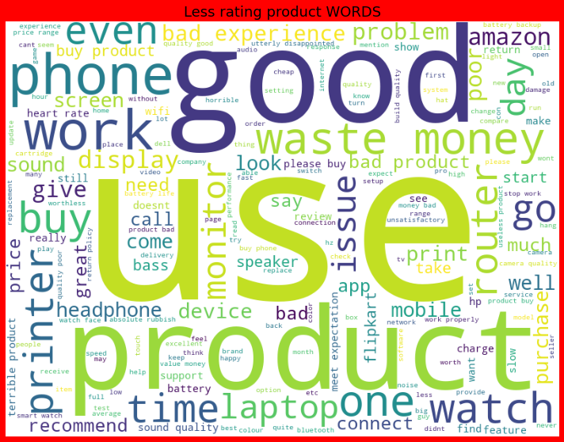
Word Cloud of Malignant comments
This is the word cloud of comments for different ratings
As we can see, the content of the word cloud are pretty offensive and we can observe some racist words used in this

Slide 11
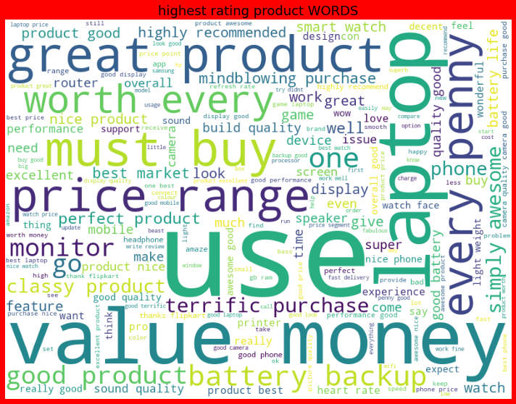
Word Cloud for 5 star rating products

Slide 12
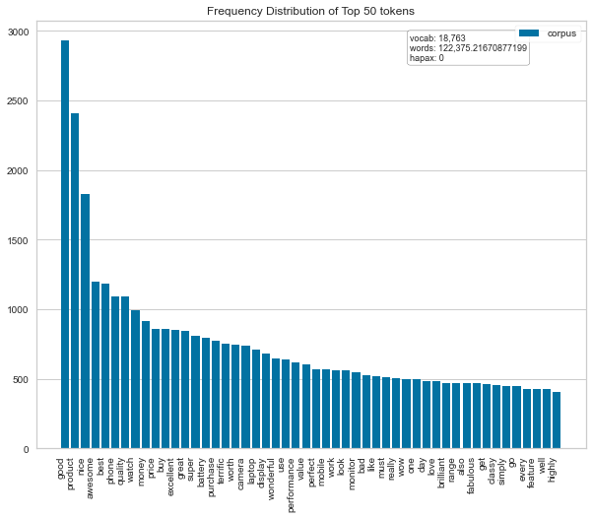
Frequency distribution of top 50 token words

Slide 13
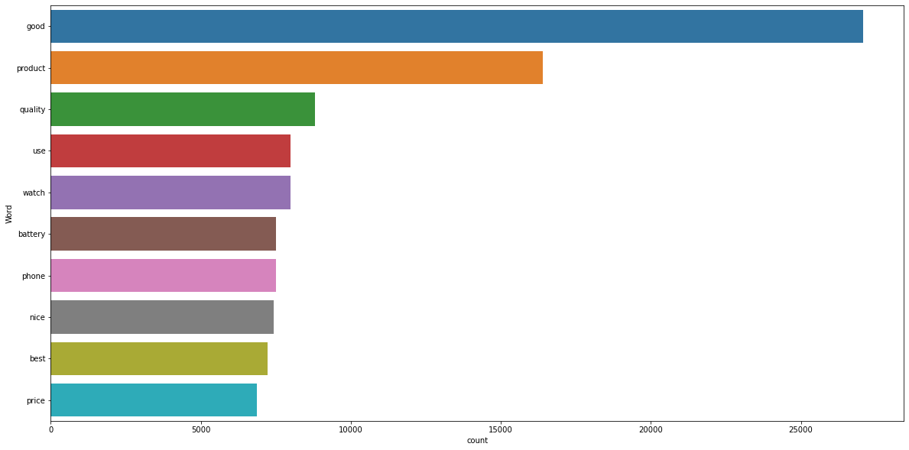
Most frequent words used in positive manner

Slide 14
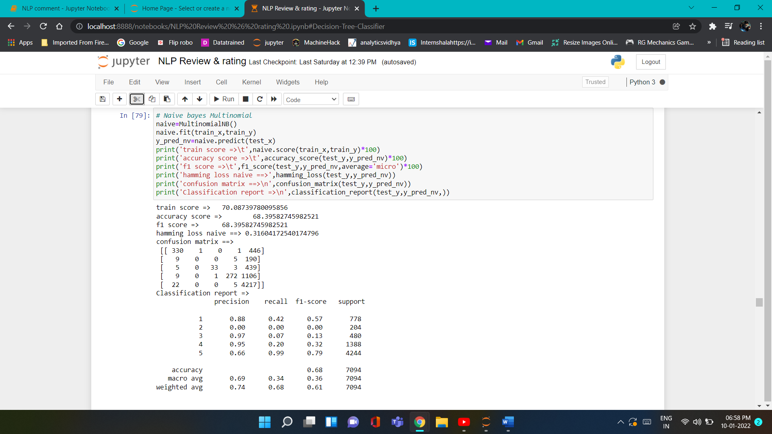
Run and evaluate select models
1). MultinomialNB:
Using Tf-idf vectorizer to extract features from clean text build different models base on that by using key metrics Accuracy score, F1 micro score,F1 weighted score, Hamming loss, on that best model will selected

Slide 15
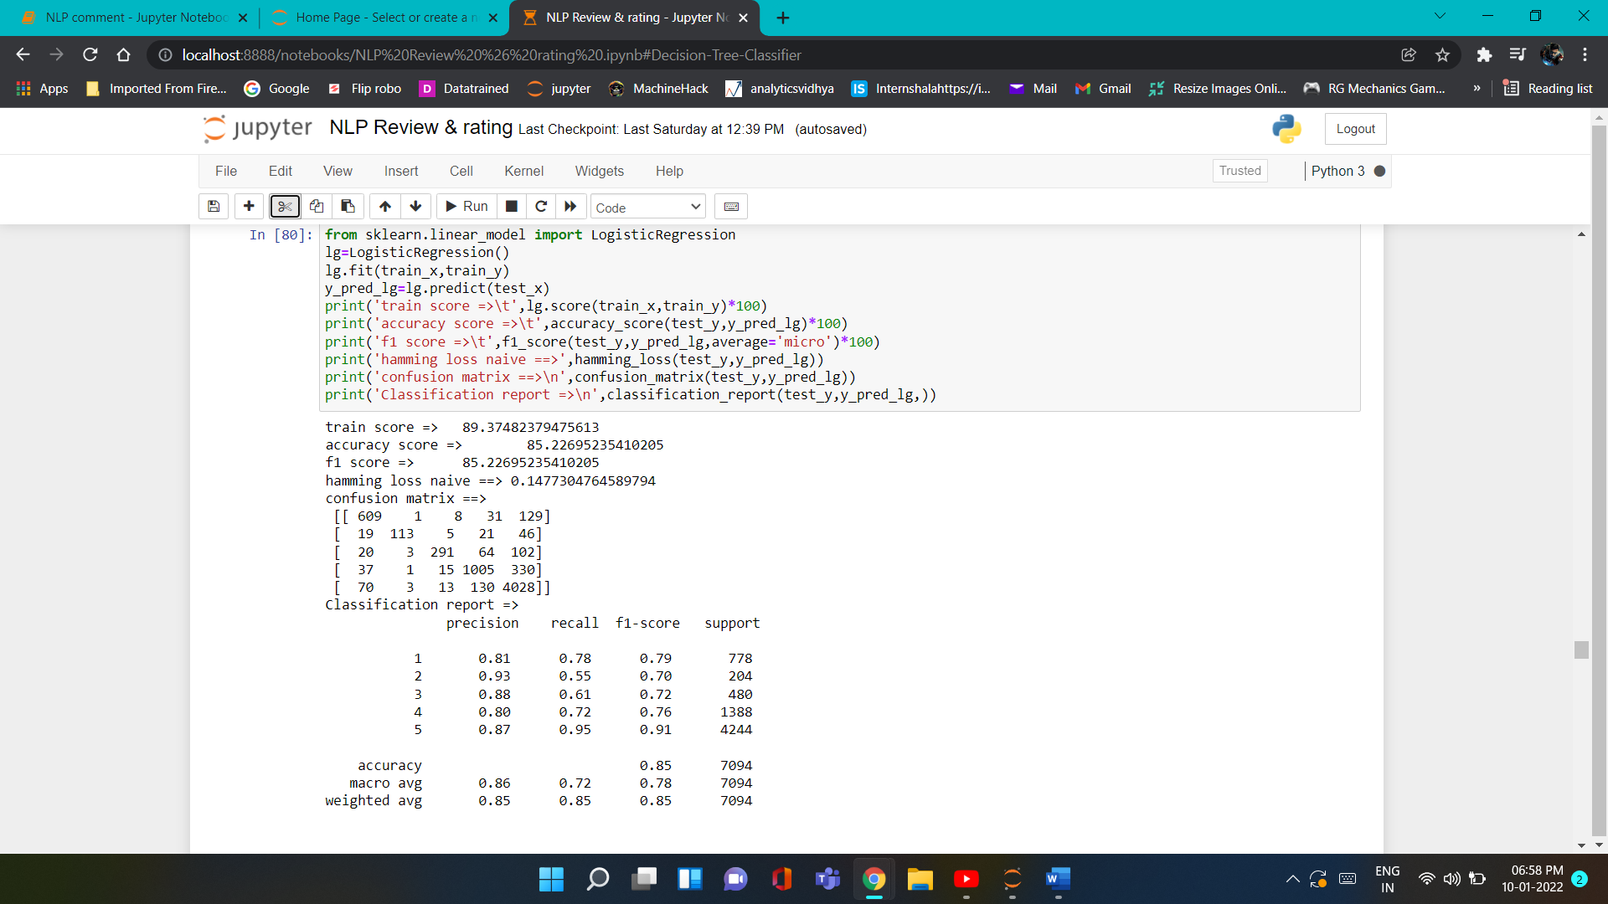
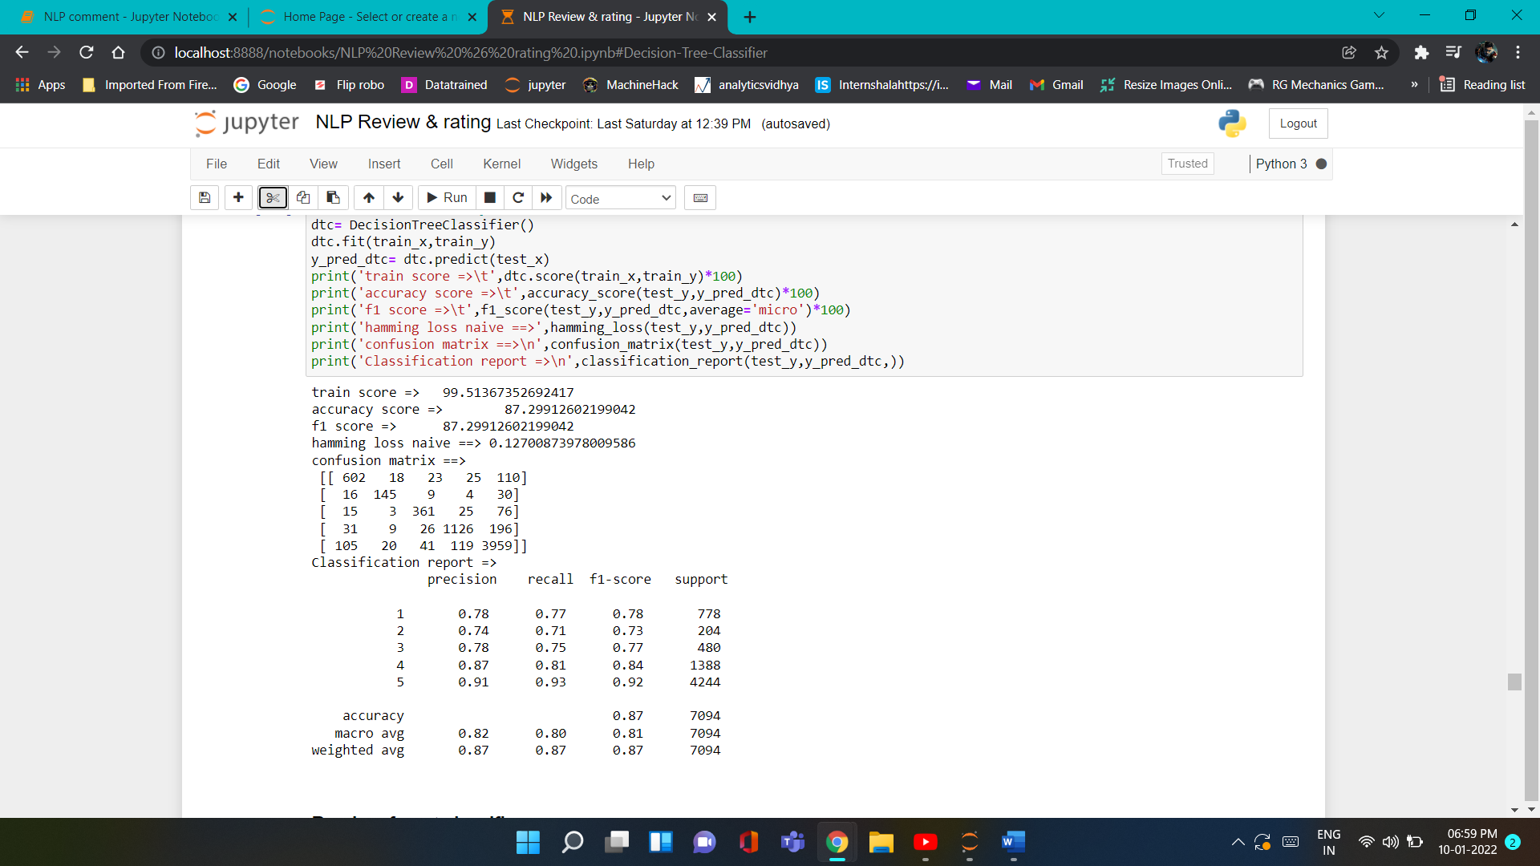
Run and evaluate select models
2). Logistic Regression
3). Decision Tree Classifier

Slide 16
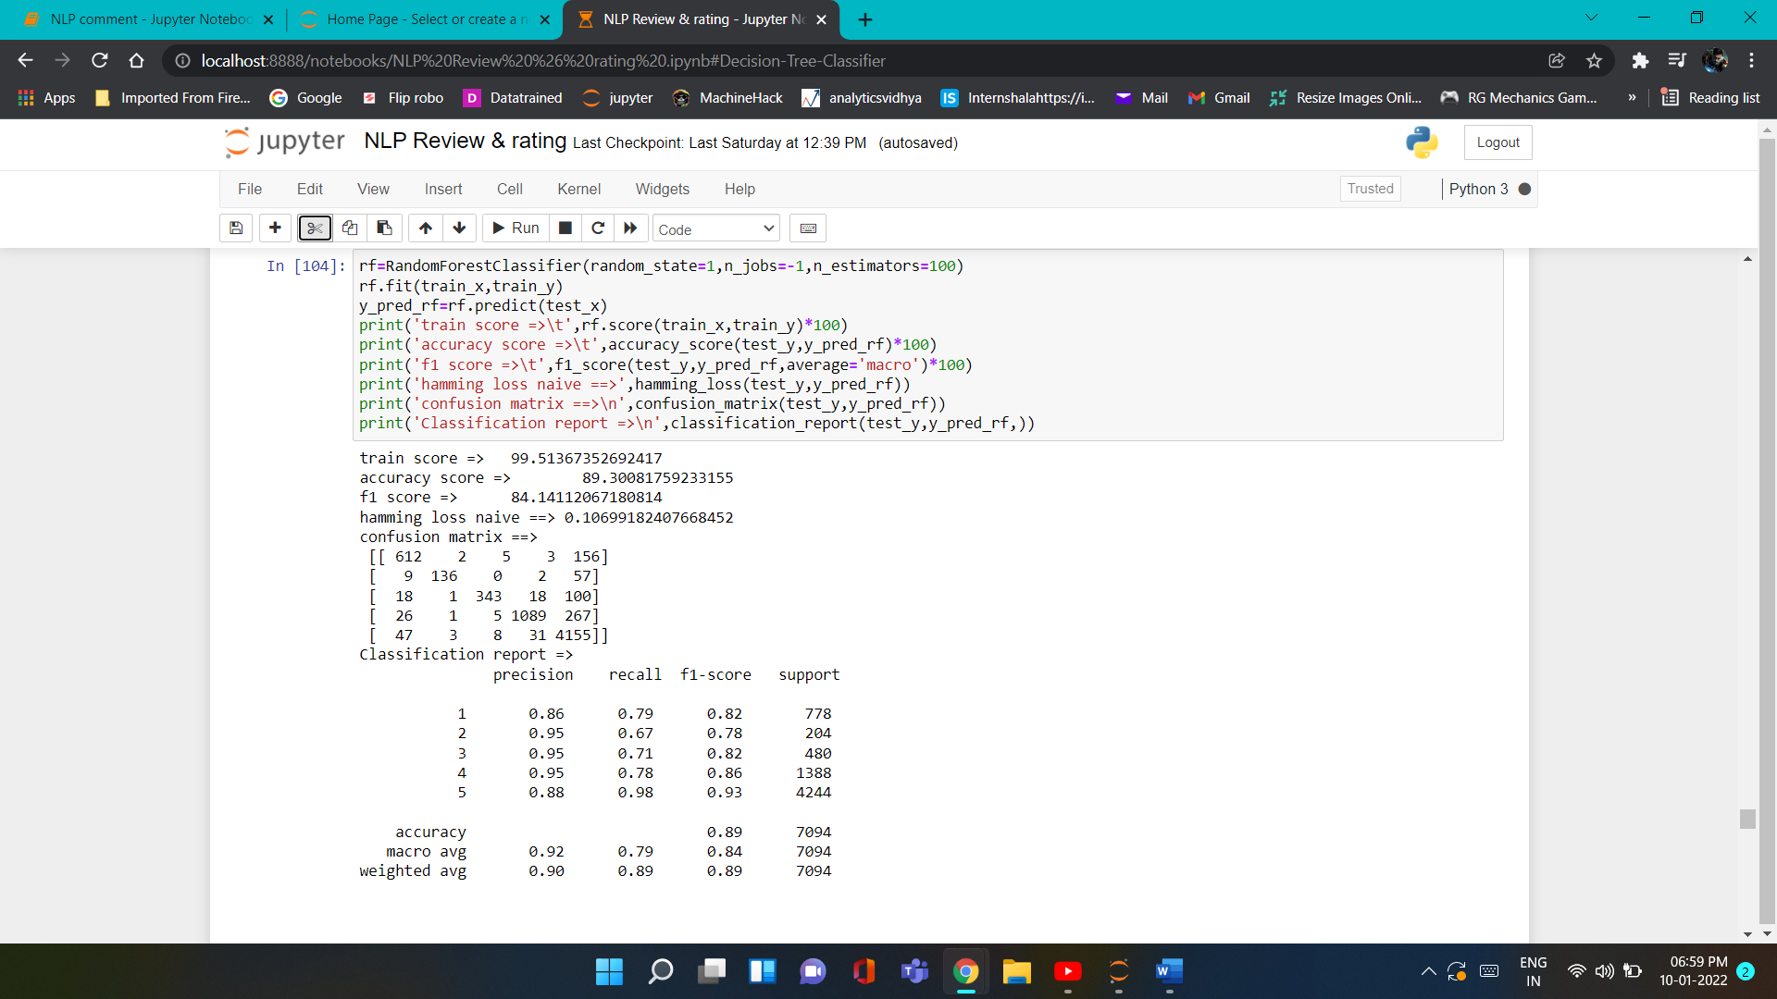
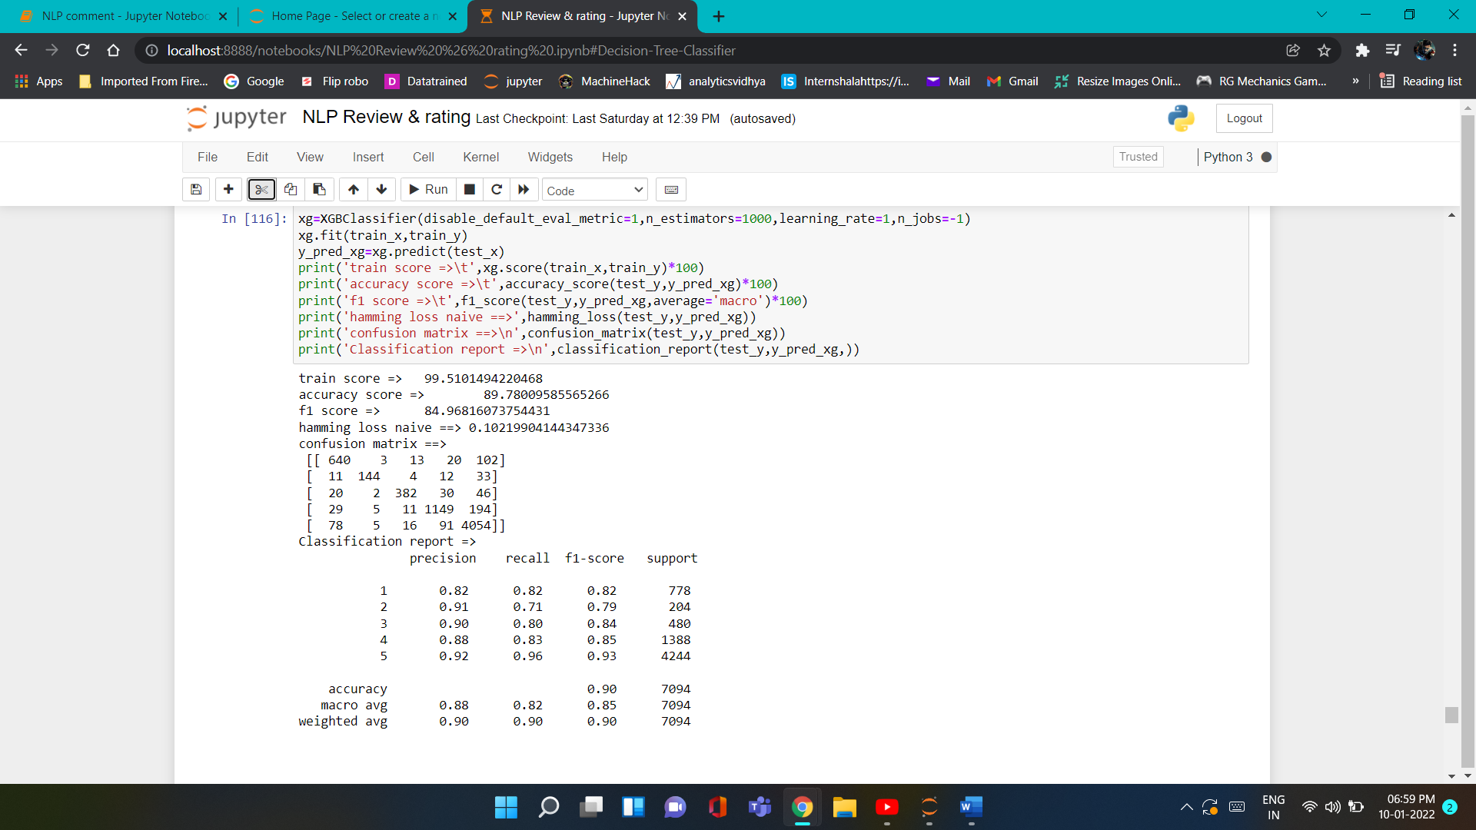
Run and evaluate select models
4). Random Forest Classifier
5). XGBoost Classifier

Slide 17
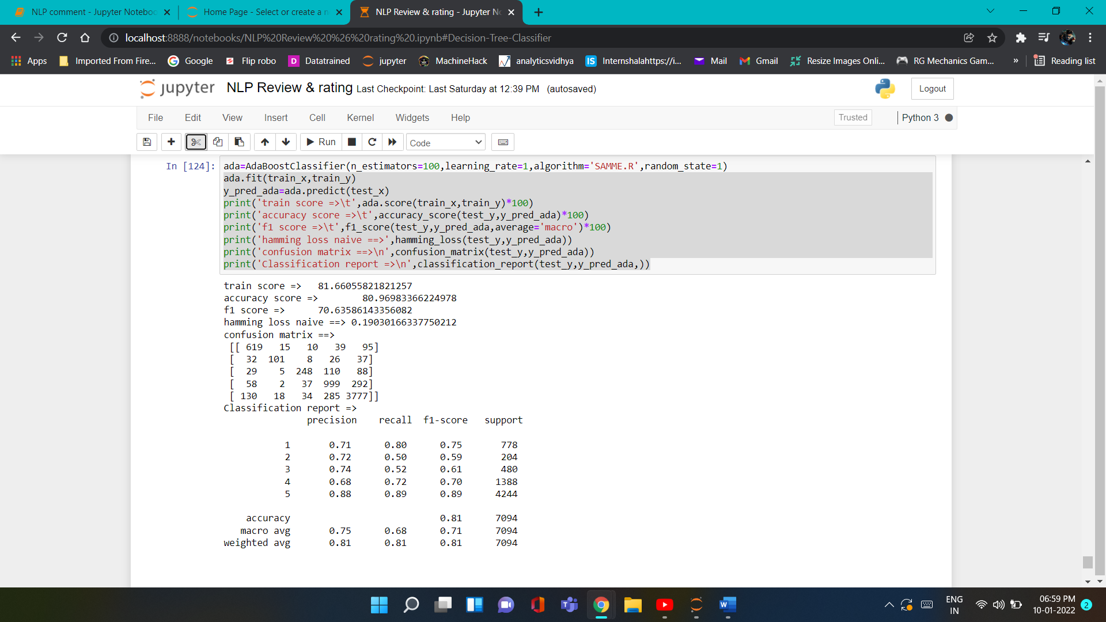
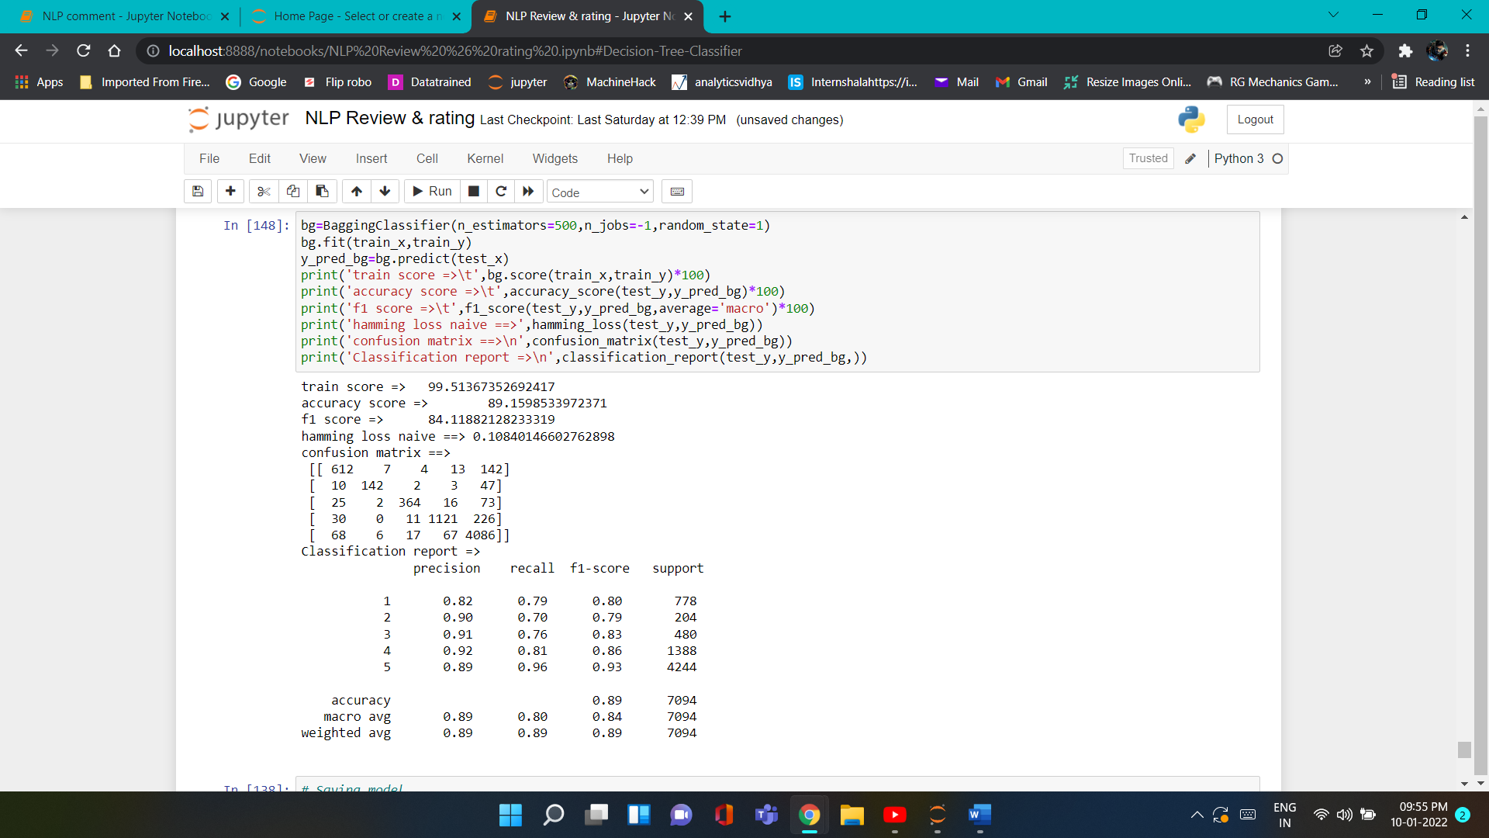
Run and evaluate select models
6). AdaBoost Classifier
7). Bagging Classifier

Slide 18
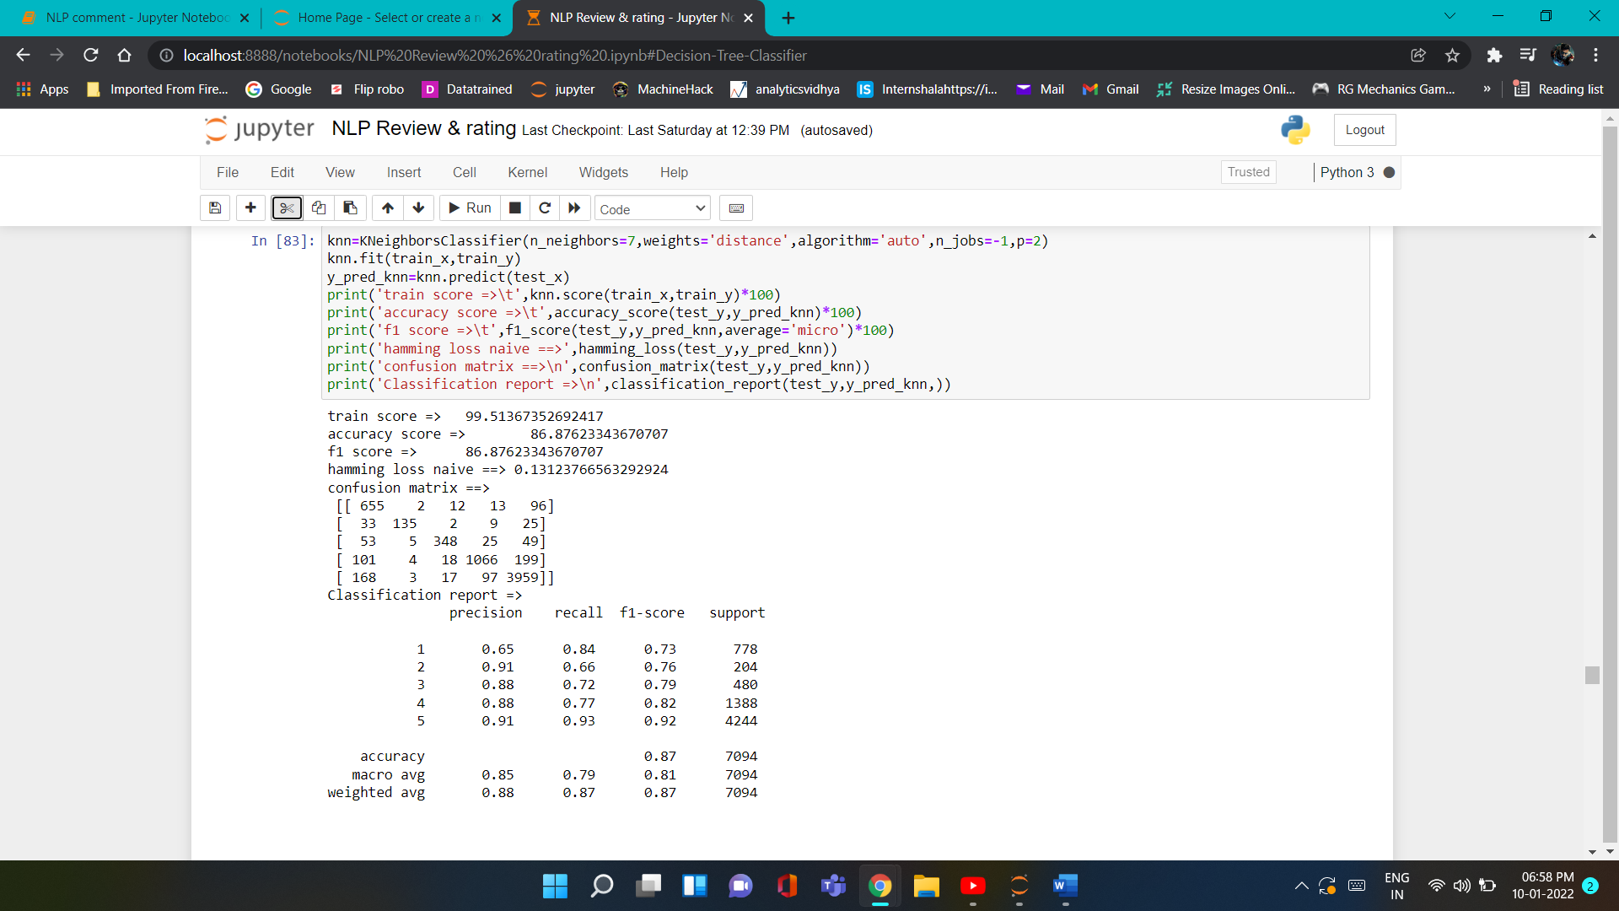
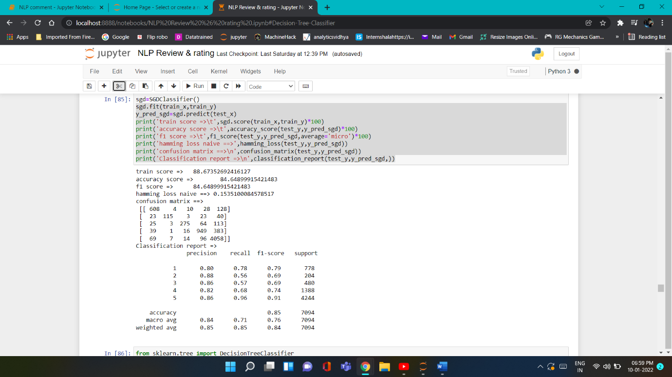
Run and evaluate select models
8). KNeighbors Classifier
9). SGD Classifier

Slide 19
Evaluate models Dashboard
Sr.NO | Model name | Hamming loss | Accuracy score % | F1_score Macro %
1 | MultinomialNB | 0.316 | 68.39 | 68.39
2 | Logistic Regression | 0.147 | 85.26 | 85.26
3 | KNeighbors Classifier | 0.131 | 86.87 | 86.87
4 | SGD Classifier | 0.153 | 84.64 | 84.64
5 | Decision Tree Classifier | 0.127 | 87.29 | 87.29
6 | Random forest Classifier | 0.106 | 89.30 | 84.14
7 | XGBoost Classifier | 0.102 | 89.78 | 84.96
8 | Adaboost Classifier | 0.190 | 80.96 | 70.63
9 | Bagging Classifier | 0.108 | 89.15 | 84.11
From all Models XGBoost have Accuracy 89.78% and F1 score 84.96%
And less hamming loss 0.102

Slide 20
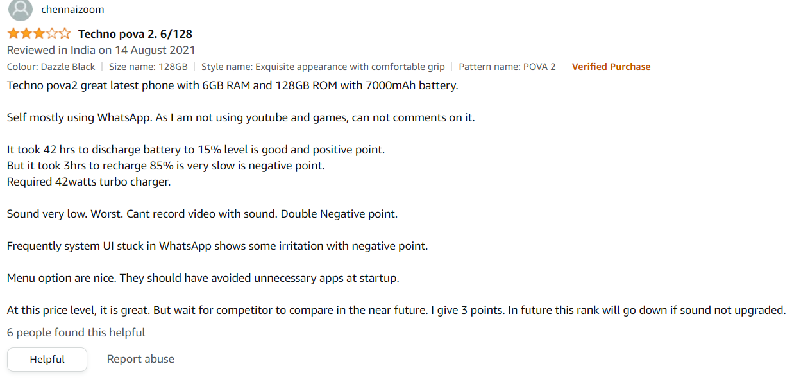
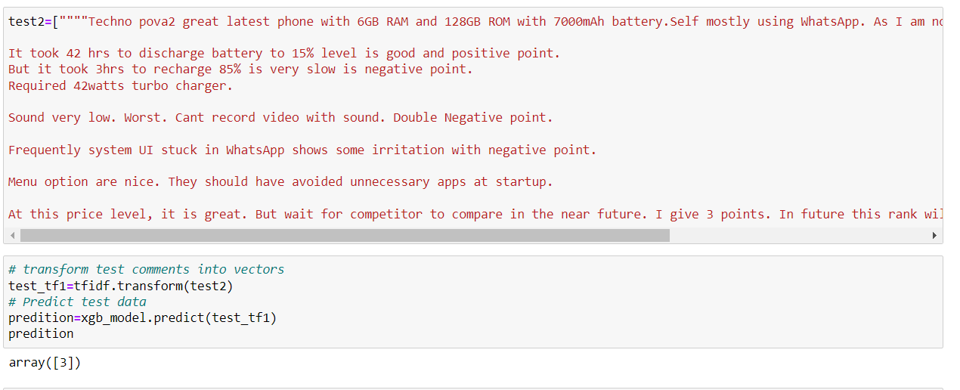
Test Model by taking

Slide 21
Conclusion
Key Findings and Conclusions of the Study
In this project report, First we have to scrape data from different websites is very useful to get live data from sources and then clean the data and pre-process and do some EDA, we have used machine learning algorithms to predict the multi-class. We have mentioned the step-by-step procedure to analyse the dataset and feature extraction. These feature set were then given as an input to algorithms. Hence, we calculated the performance of each model using different performance metrics and compared them based on these metrics. Then we have also saved the best model and predicted the label.

Slide 22
Limitations of this work and Scope for Future Work
The same problem can be solved using deep learning.
For that our model train on small data set so we no sure for accuracy of model perform well on different reviews.
This model can further improved by additional algorithms.

Slide 23


